Slide 1
Design and Evaluation of a Framework for Annotating Coloured Petri Net Models with Code Generation Pragmatics
Notes:
Welcome to this master thesis presentation, I’ll be short on time so no questions until the end.

Slide 2
Overview
Intro
Model Driven Software Engineering
Thesis motivation, aim and method
Case: WebSocket
Protocol
Coloured Petri Net Model
Analysis, State Space
Prototype: Pragma/CPN
Demonstration
Evaluation

Slide 3
Model Driven Software Engineering
(MDSE)

Slide 4
Model Driven Software Engineering
Model centric
Everything is a model, or is derived or generated from a model
Abstraction
Platform independence
Reusability
Analysis
Notes:
Is a software development methodology that puts models in the center of the process.
serve both as documentation and as a basis for implementation

Slide 5
Model Driven Software Engineering
Key Concepts
Modeling and meta-modeling
Models describing models
Model Transformation
Generating artifacts from models
Especially code generation

Slide 6
Model Driven Software Engineering
Modeling in Solution Domain
Vs
Modeling in Problem Domain
↓
Domain Specific Modeling Language (DSML)
Notes:
Before describing metamodeling, explain the reason for it.
KW: Using concepts in target domain
Creating a DSML is the largest hurdle, and can be costly
Need to create both the language and the tools to support it
Allows for reuse in target domain
A modeling language is good if its models make sense from the point of view of a user that is familiar with the domain, and if they can serve as a basis for implementing systems.
Not feasible to create one such language that fits all problem domains, thus research into effective methods for developing new ones

Slide 7
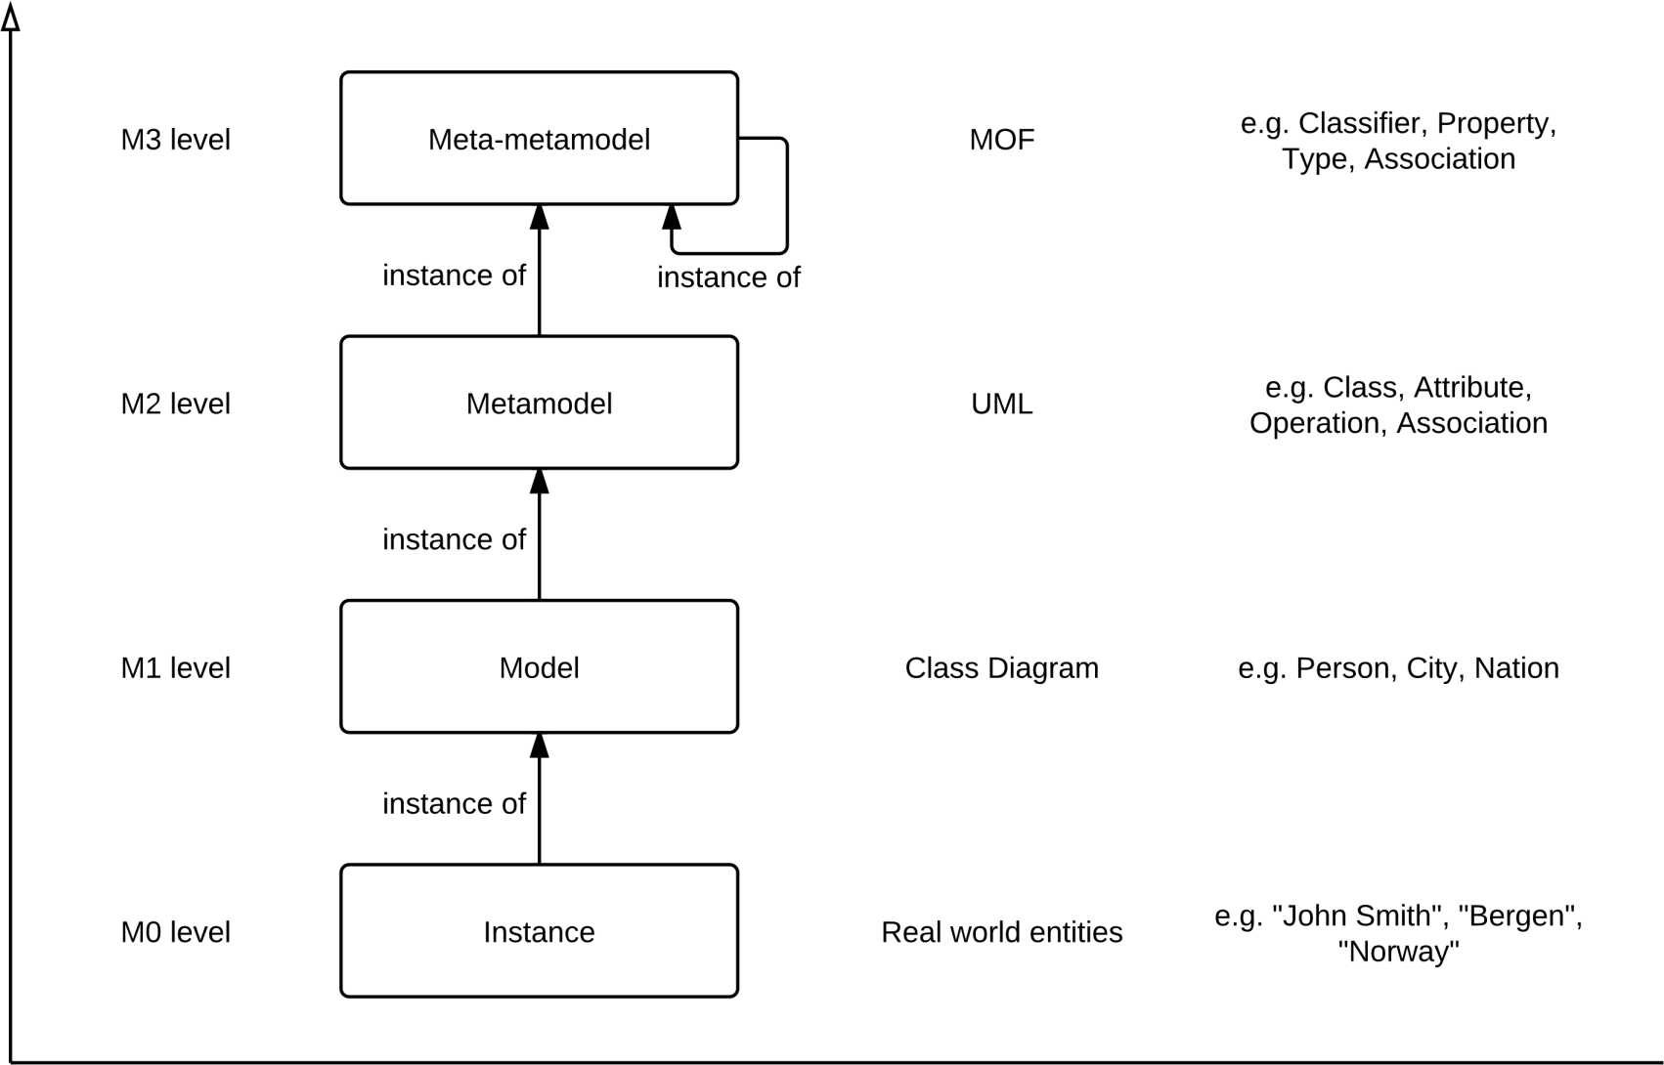
UML and Meta Object Framework
Notes:
Created by Object Management Group (OMG) to provide the basis for metamodel definition in OMG’s family of modelling languages, particularly UML
Example of DSML in solution domain.

Slide 8
Background
Kent Inge Fagerland Simonsen: On the use of pragmatics for model-based development of protocol software. PNSE’11
Defining a DSML for protocol software
Coloured Petri Net (CPN) model annotated with code generation pragmatics
Platform model to describe implementation details for particular platform
Configuration model for particular protocol model
Notes:
Lot of research to develop DSML for different problem domains.
PNSE = Petri Nets and Software Engineering. International Workshop
CPN is a type of directed graph useful to model processes, especially with
Traits like asynchronous and concurreny, parallellism
Good methods for analysis, as I’ll show later

Slide 9
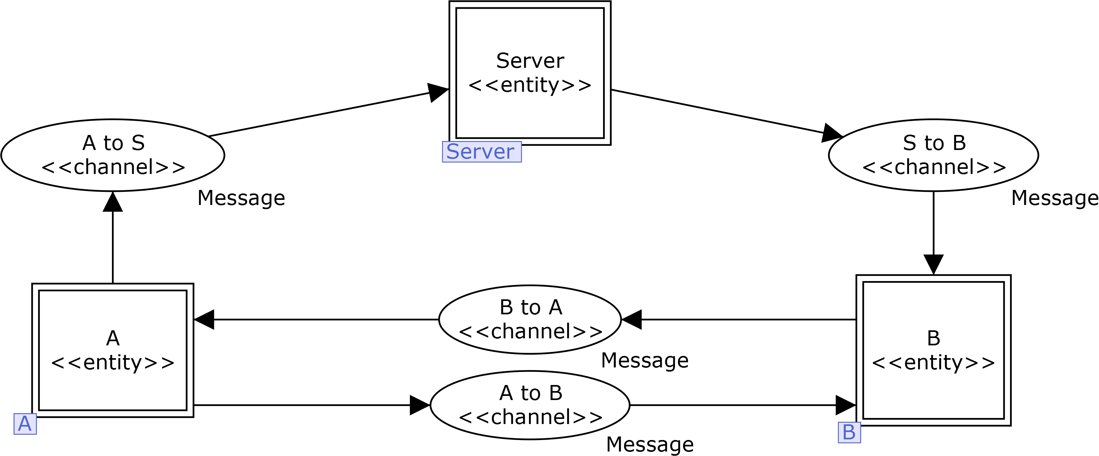
Kao-Chow authentication protocol
Notes:
Simonsen used KC as example
Used CPN Tools to annotate the model. Tedious, required lots of workarounds
Need for a dedicated tool for this task

Slide 10
Thesis Aim
Support annotation of CPN models with code generation pragmatics in a flexible and model-centric manner
Notes:
Based on Simonsens work, blablabla
By flexible we mean extensible,

Slide 11
Research Method
Create a prototype application framework
Evaluate it by annotating a selected set of CPN models of communication protocols

Slide 12
Prototype Requirements
Importing CPN Tools models.
Annotate model with pragmatics.
Provide only pragmatics that are applicable to the selected model element.
Loading sets of domain-specific pragmatics
reduce cluttering and potentially avoid performance reductions
Define set(s) of model-specific pragmatics

Slide 13
Pragmatics Categories
General pragmatics
protocol entities, communication channels, external method calls, API entry points
Domain specific pragmatics
apply to all (or many) protocols within a particular domain
Security protocols: encryption, decryption, nonce generation.
Model specific pragmatics
apply only to the specific model instances in which they are defined
label concepts unique to that model.
Notes:
for operations like establishing a connection, and sending or receiving data.

Slide 14
Case Study: WebSocket Protocol

Slide 15
WebSocket Protocol
Enables two-way communication between a client running untrusted code in a controlled environment to a remote host that has opted-in to communications from that code.
Goal: More efficient and simpler two-way communication for web apps
Origin-based security model
Data frames and control frames
Masking of frames
Prevent attacks on caching intermediaries
Fragmentation of frames
When message length is unknown

Slide 16
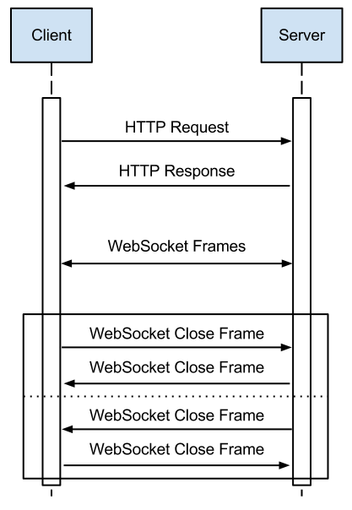
Sequence Diagram WebSocket Protocol

Slide 17
WebSocket CPN Model

Slide 26
Client-side
Server-side

Slide 28
State Space Analysis

Slide 29
State Space Analysis
Exploring every possible reachable marking of a model
Investigate properties of the net
Reachability, Boundedness, Home properties, Liveness, Fairness
Limitations
State Space Explosion
Non-deterministic randomness
Notes:
Remember suggested remedies for limitations

Slide 30
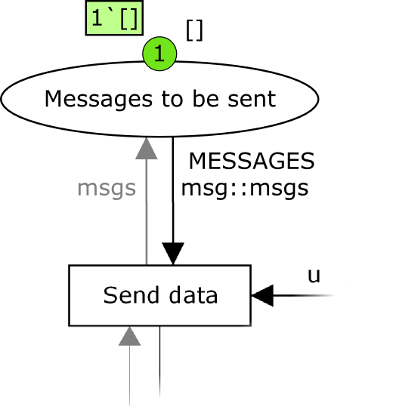
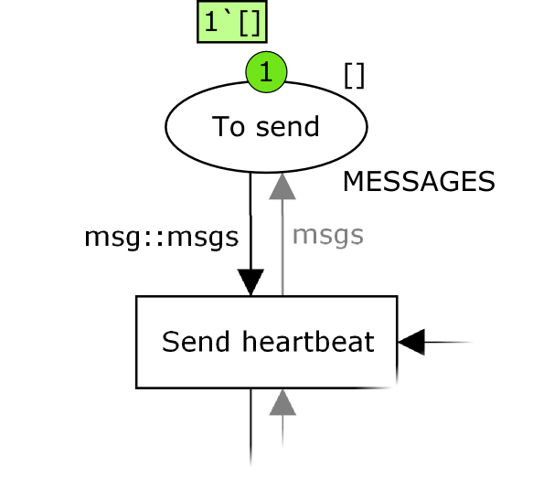
State Space Analysis
Configuration: Only establish connection, no data being sent

Slide 31
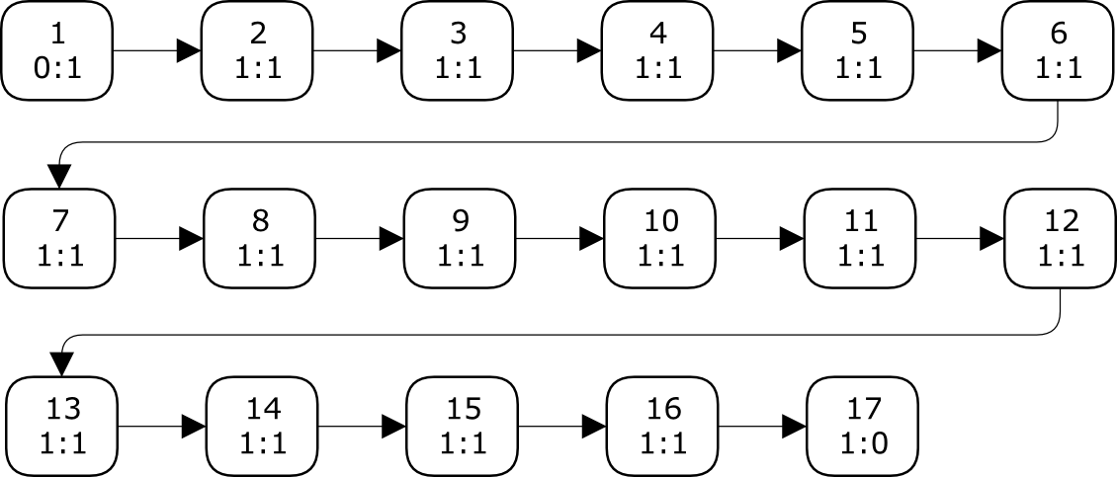
State Space Analysis
State Space
Nodes: 17
Arcs: 16
Secs: 0
Status: Full
Scc Graph
Nodes: 17
Arcs: 16
Secs: 0

Slide 32
State Space Analysis
Larger configurations
One short message
Nodes: 29, Arcs: 28
One ping, then one message
Nodes: 475 Arcs: 1140
Notes:
Order of magnitude larger

Slide 34
State Space Analysis
One message, then one ping
Nodes: 513, Arcs: 1141
Home Markings: None
Dead Markings: [512,513]
One long message
Nodes: 813, Arcs: 2331, Secs: 2
Ping, Text, Close
Nodes: 6129, Arcs: 19625, Secs: 14
Dead Markings: 6 [6129,6112,6029,5960,5632,...]

Slide 35
State Space Analysis
One more message
Nodes: 165 748, Arcs: 707 380, Secs: 18 000 (5h)
Status: Partial
Notes:
The report also showed that it had not detected any cycles, which reinforces the claim that the model works as it should.
uncovering problems with the WebSocket CPN model, and effectively allowing us to conclude that the model is now valid
All but two of the transitions are enabled at some point; the two exceptions are Fail in the ClientApplication module and Send Reject in the ConnectionResponse module
This means we have full coverage

Slide 36
Pragma/CPN
Notes:
Name chosen to mimick other tools that work with CPN Tools, like Design/CPN, Access/CPN, and the recent Grade/CPN

Slide 37
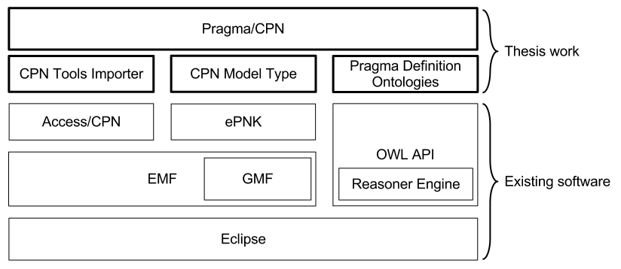
Pragma/CPN
Notes:
Everything is Open Source
Eclipse: Application platform with plugin framework, IDE focus. Famous for its Java IDE
AccessCPN

Slide 38
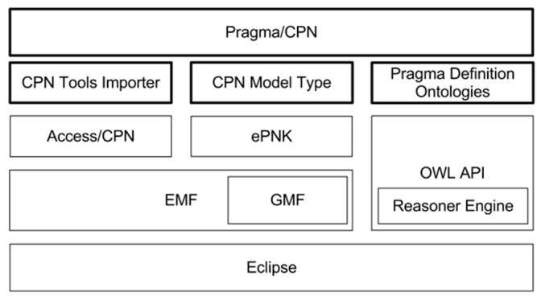
Pragma/CPN
Eclipse Modeling Framework
Model driven approach to Java software development
Ecore
meta-metamodel
specialisation of MOF
Generate Java implementation from model
Adapter classes for viewing and command-based editing
Generate simple editors
Graphical Modeling Framework (GMF)
Create graphical diagram editor

Slide 39
Pragma/CPN
ePNK
Generic framework for working with standard Petri Net types
Saves models in PNML format
Tree editor and diagram editor
Supports creating custom specialised Petri Net types
Using EMF models

Slide 40
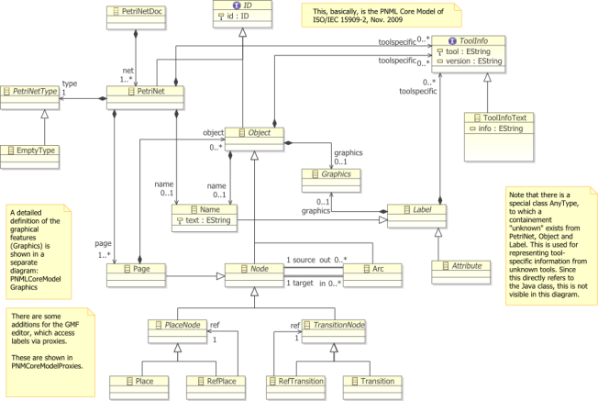
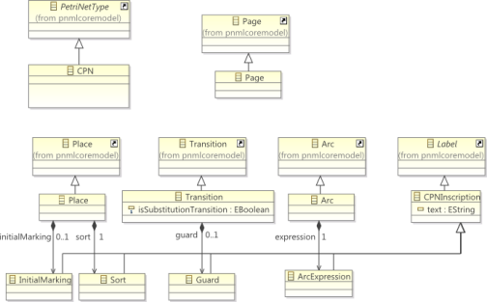
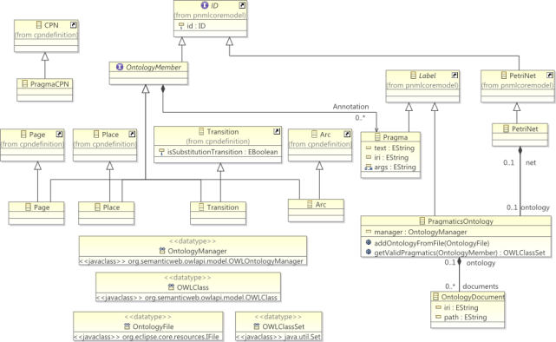
Pragma/CPN
CPN Model Type
ePNK PNML Core Model
CPN Model Type
Annotated CPN Model Type

Slide 41
Pragma/CPN
OWL API
Library for working with ontologies
Represent body of knowledge in a particular domain
Classes, properties, individuals
Axioms that define relations, restrictions
Very expressive
Different syntaxes
Reasoner engine
Deduction and entailment
Can infer implicit rules
Notes:
We decided after talking with Simonsen to represent pragmatics using ontologies

Slide 42
Pragma/CPN
Pragmatics Definition Ontology
Three base ontologies
CPN
Pragmatics and relation to CPN
Generic Pragmatics
Using reasoner engine, we can deduce appropriate pragmatics for selected model elements

Slide 43
Demonstration

Slide 44
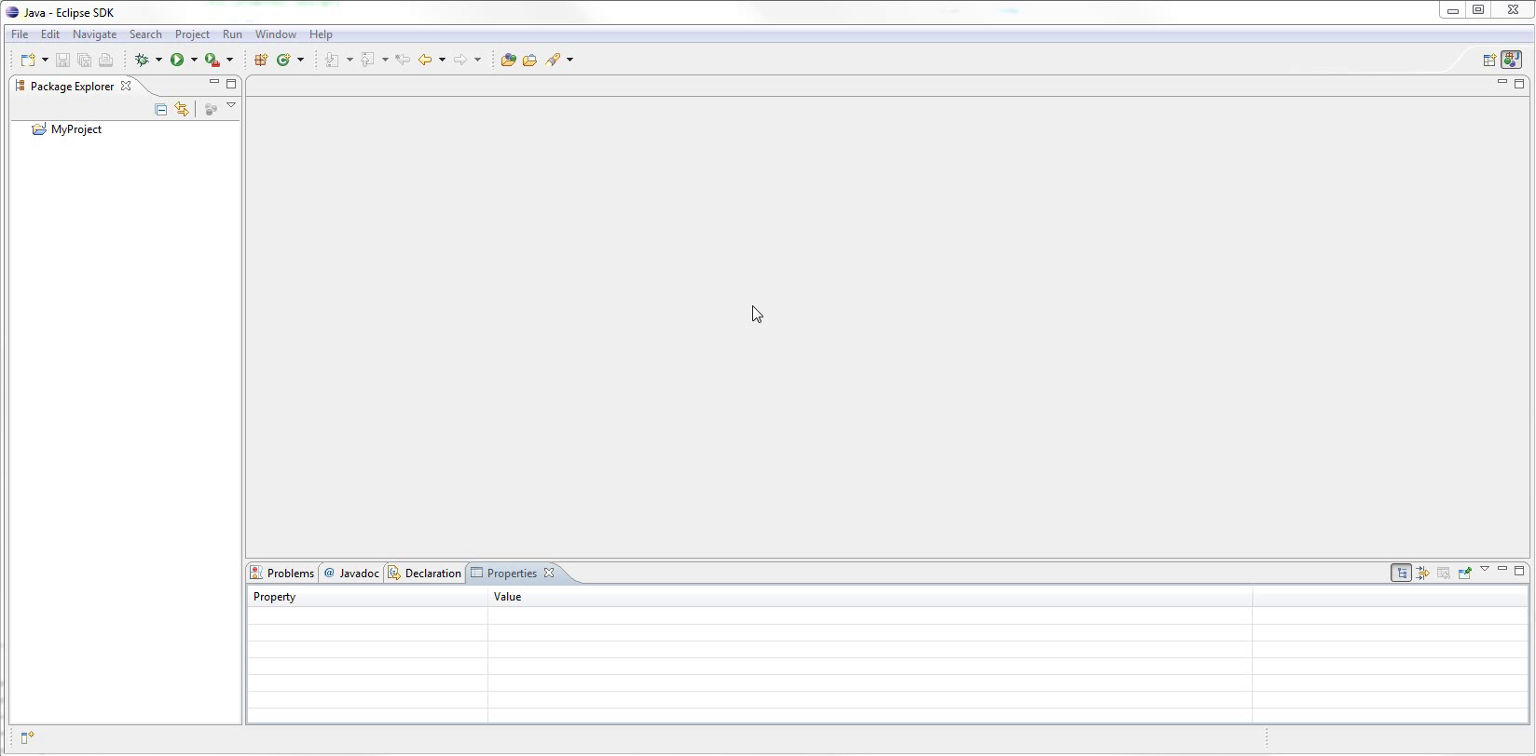
Notes:
Basic Eclipse setup
Toolbars
Package Explorer
Editor
View
Very customisable

Slide 45
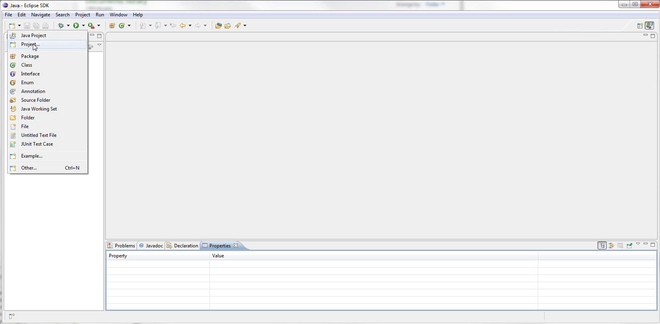
Notes:
Start with creating new project
Zoom

Slide 46
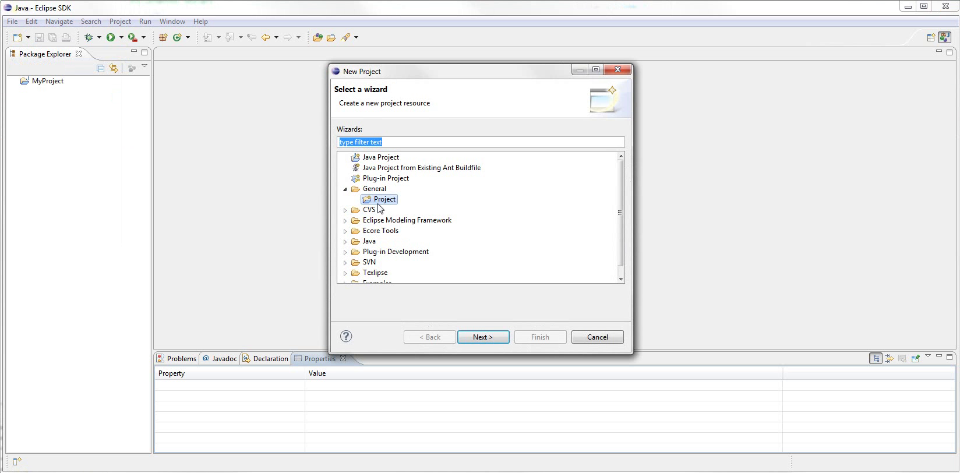
Notes:
Wizard
zoom
lets you choose several types of project
We just need general project

Slide 47
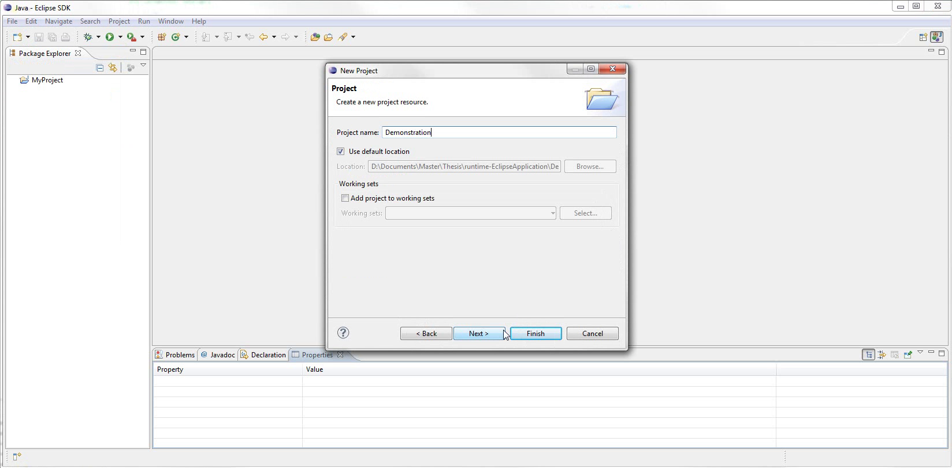
Notes:
We give the project a name
Can choose location and other settings
Hit Finish

Slide 48
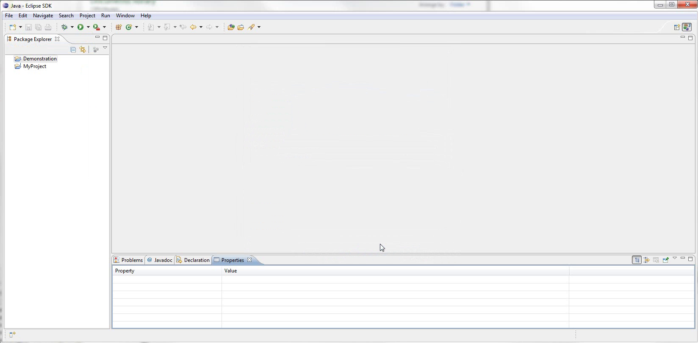
Notes:
Can see the project in explorer
We now want to import the Websocket CPN model
More than one way to run importer

Slide 49
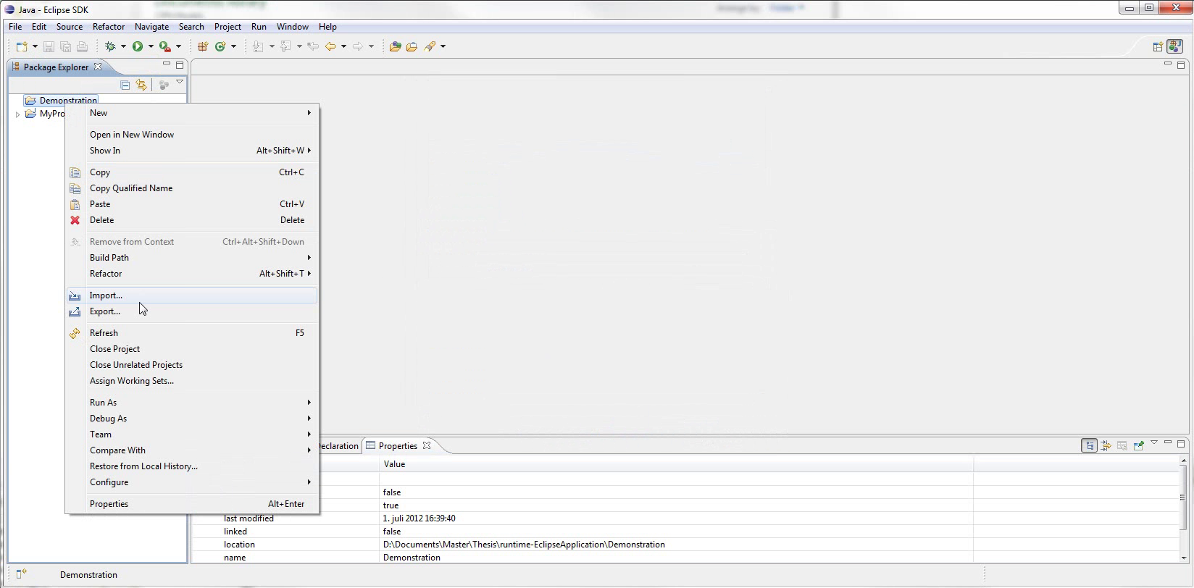
Notes:
Right click project and select import

Slide 50
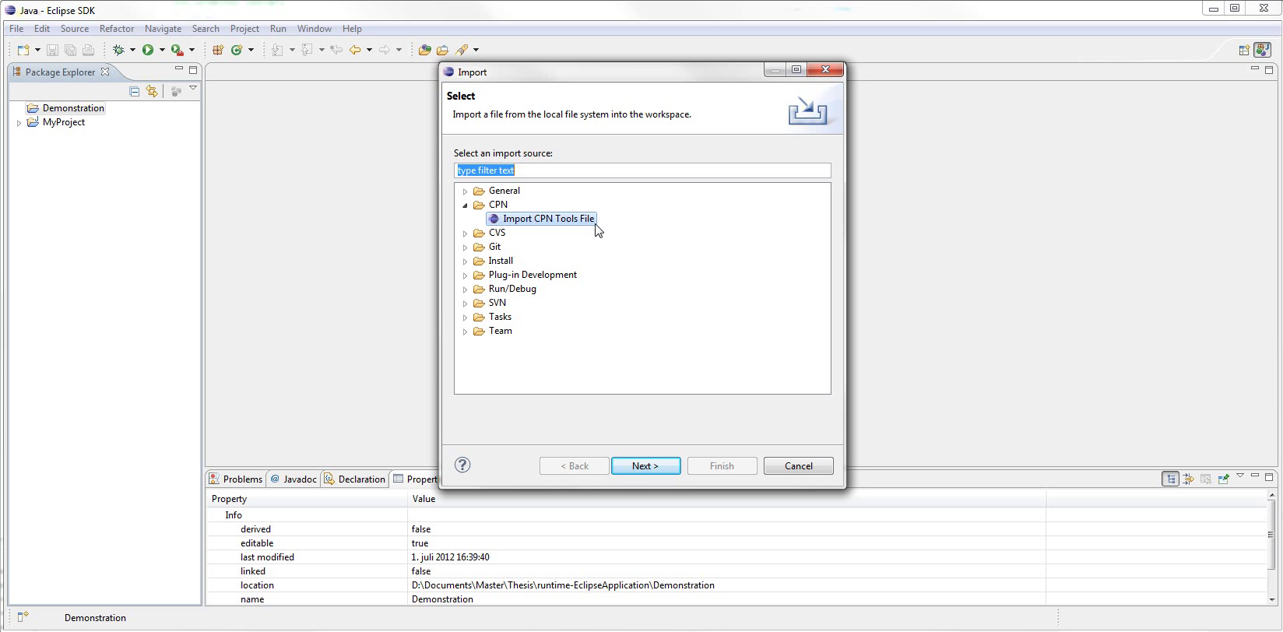
Notes:
This is Import dialog
Zoom
Can select from many available importers

Slide 51
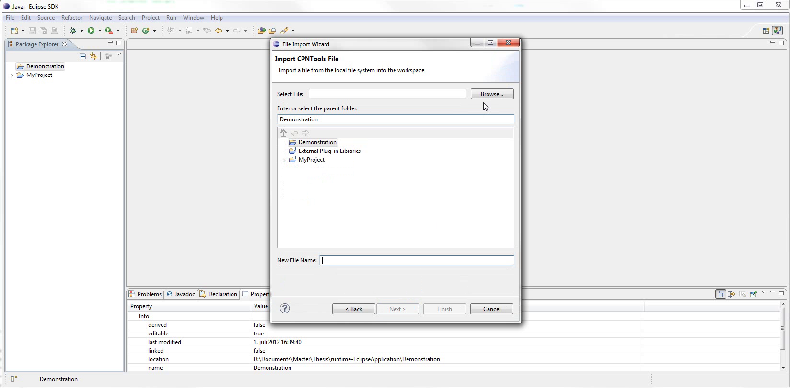
Notes:
This is the CPN importer
Need two things:
Select the cpn file to import
Select where to put the imported model
So we hit Browse...

Slide 52
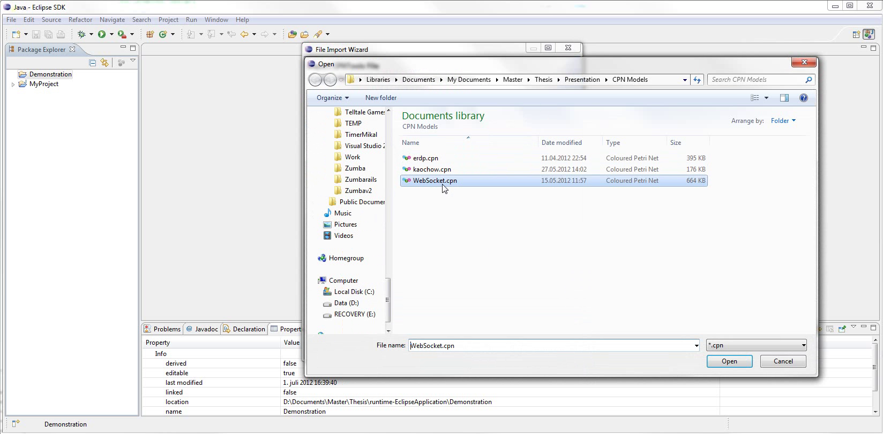
Notes:
Select the cpn file

Slide 53
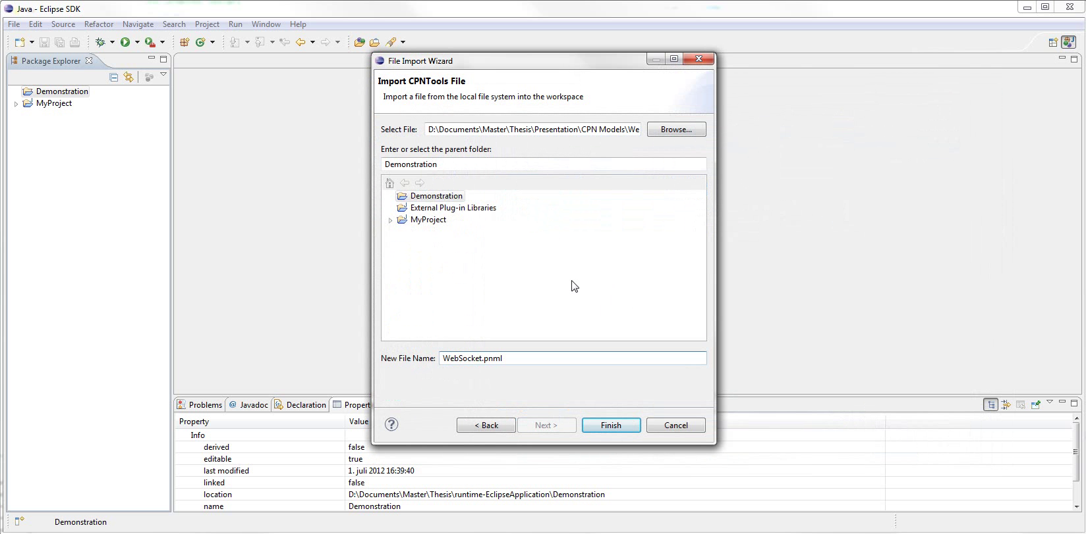
Notes:
Demonstration project already selected
File name suggested (new extension)

Slide 54
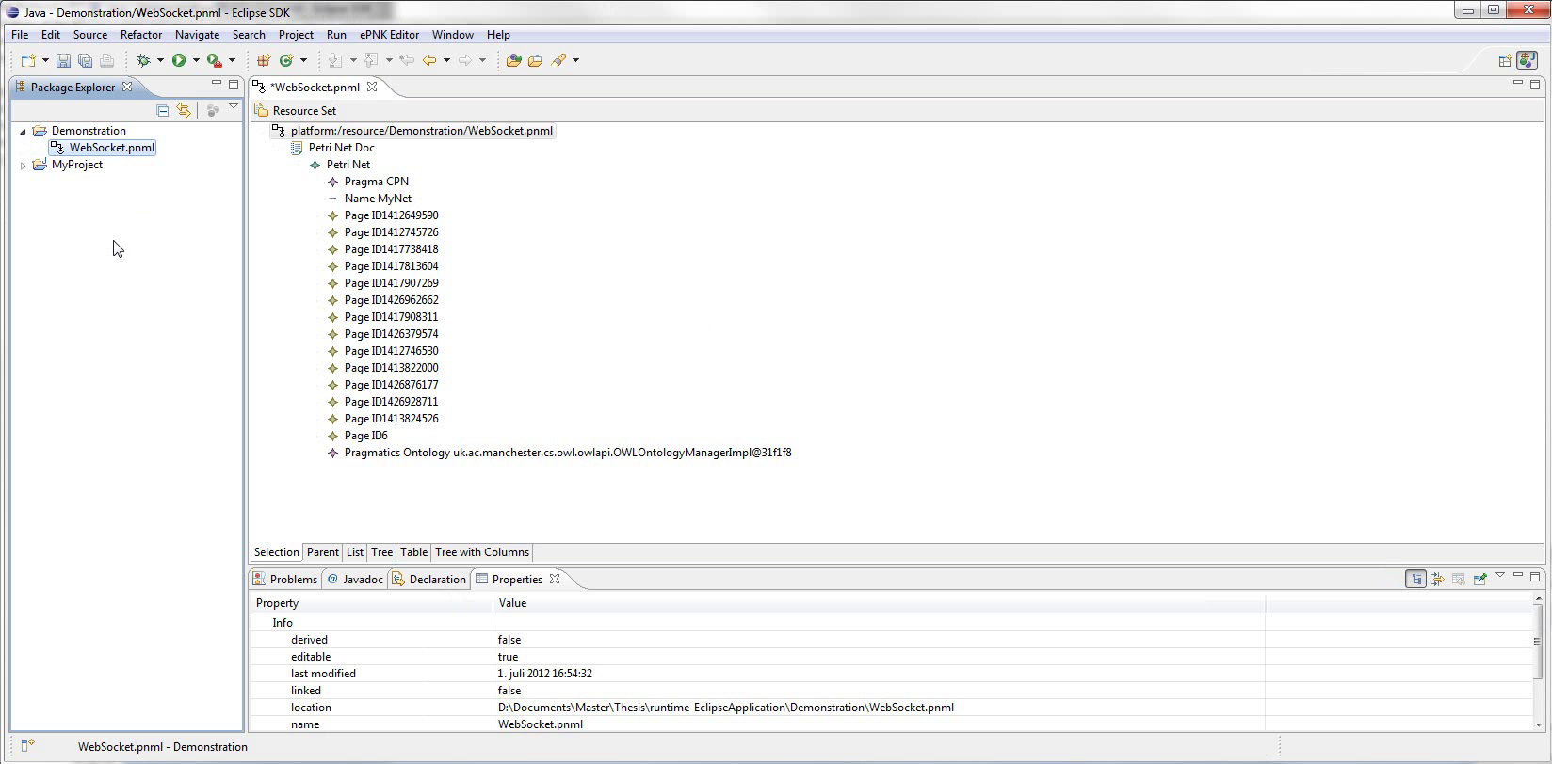
Notes:
Here is result
Note file contained in project
Model elements labeled by ID
Also have a Pragmatics Ontology instance

Slide 55
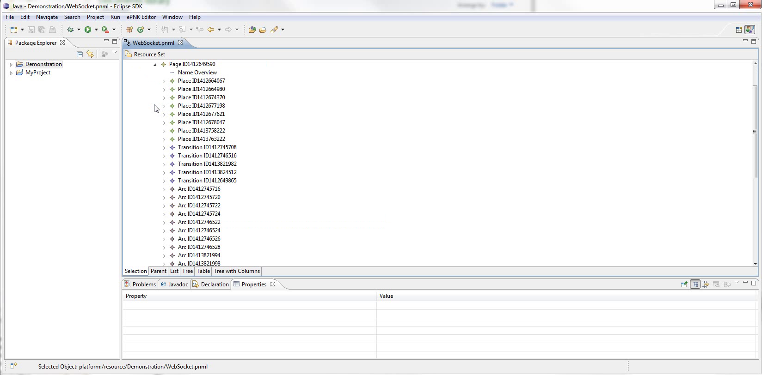
Notes:
Here is the child elements of the Overview page

Slide 56
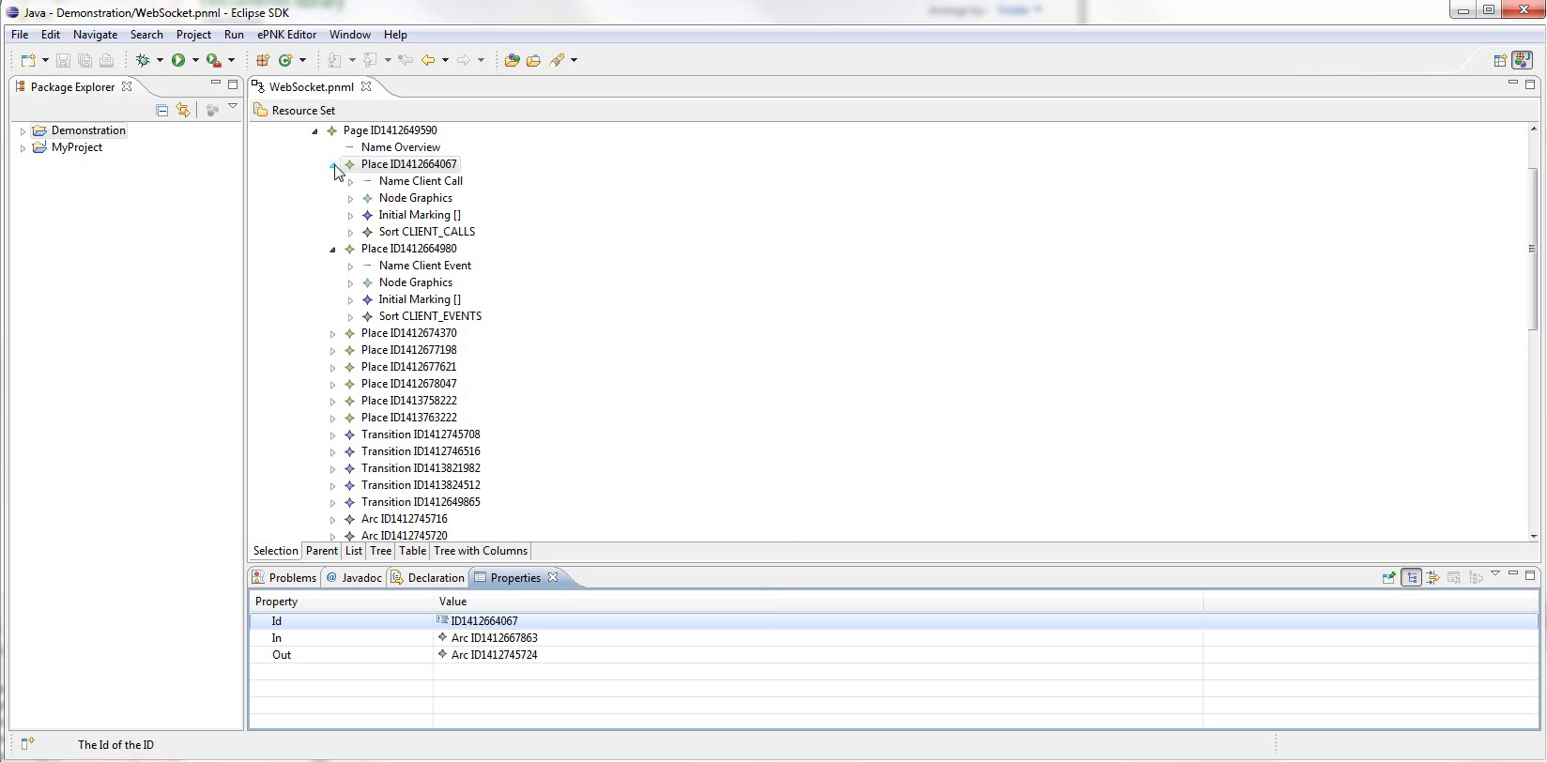
Notes:
A few places expanded to show their child elements
Reasons for this
Note properties view at bottom

Slide 57
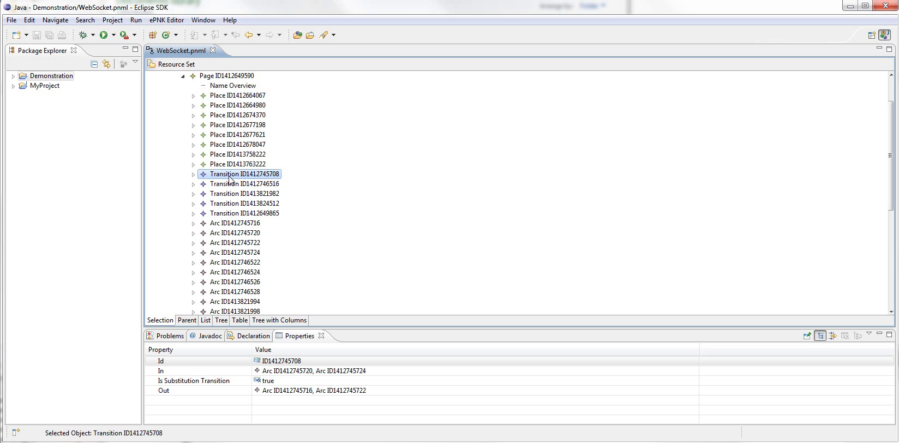
Notes:
Different for each element
Zoom for details

Slide 58
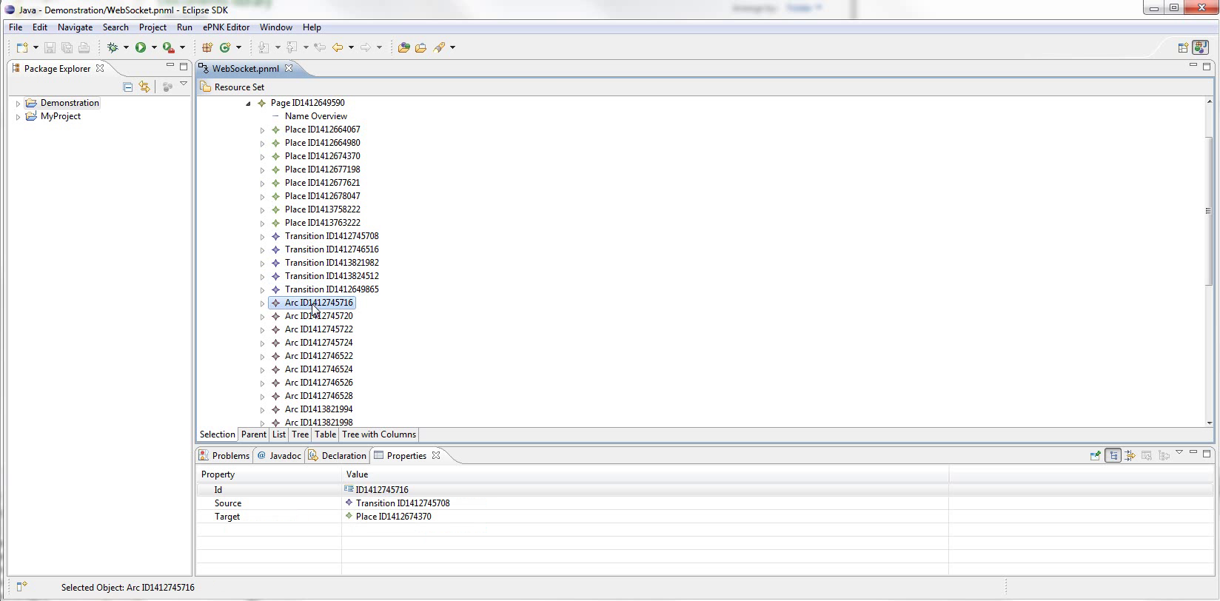
Notes:
A bit difficult to visualise
So by double clicking a page, we can open the diagram editor

Slide 59
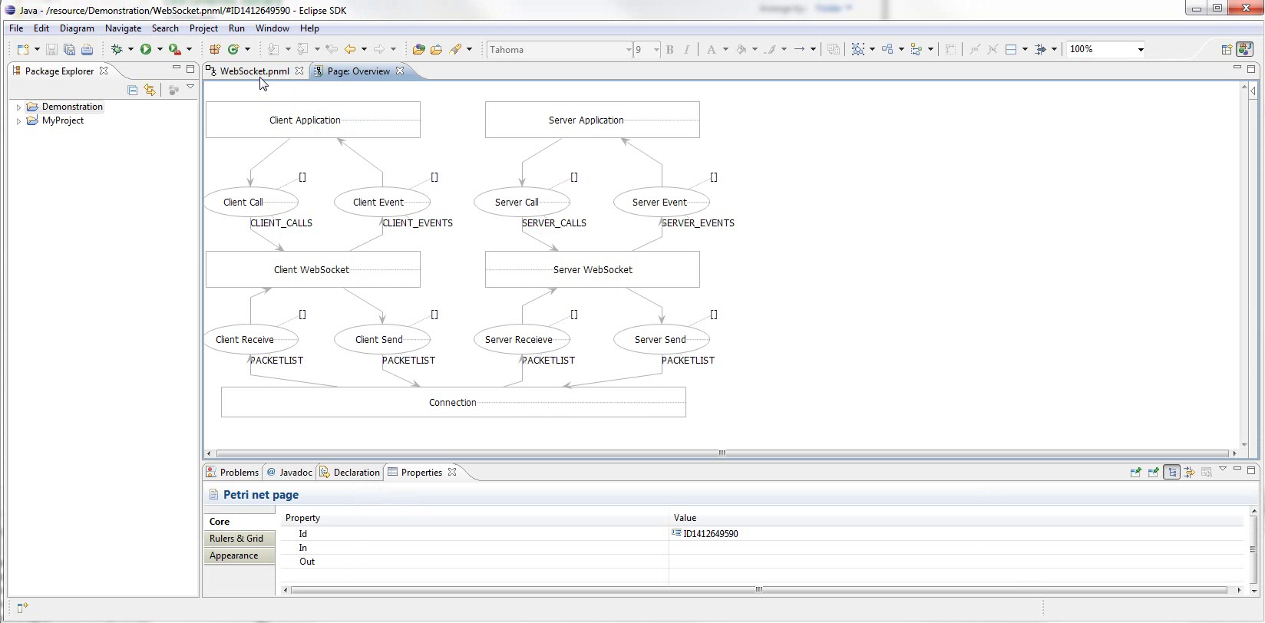
Notes:
Here it is.
Layout isn’t perfectly mirrored from CPN Tools, but everything can be manually adjusted.
Eclipse is very customisable, so we can...

Slide 60
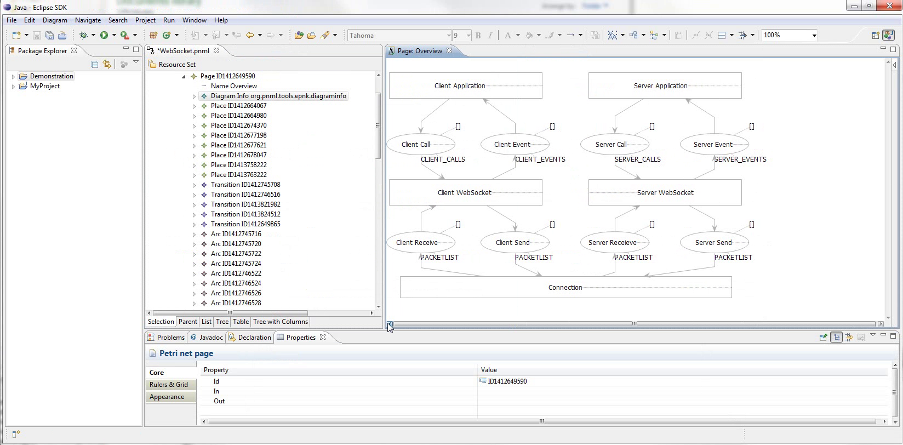
Notes:
... Show both editors at once.
Unfortunately not synchronised

Slide 61
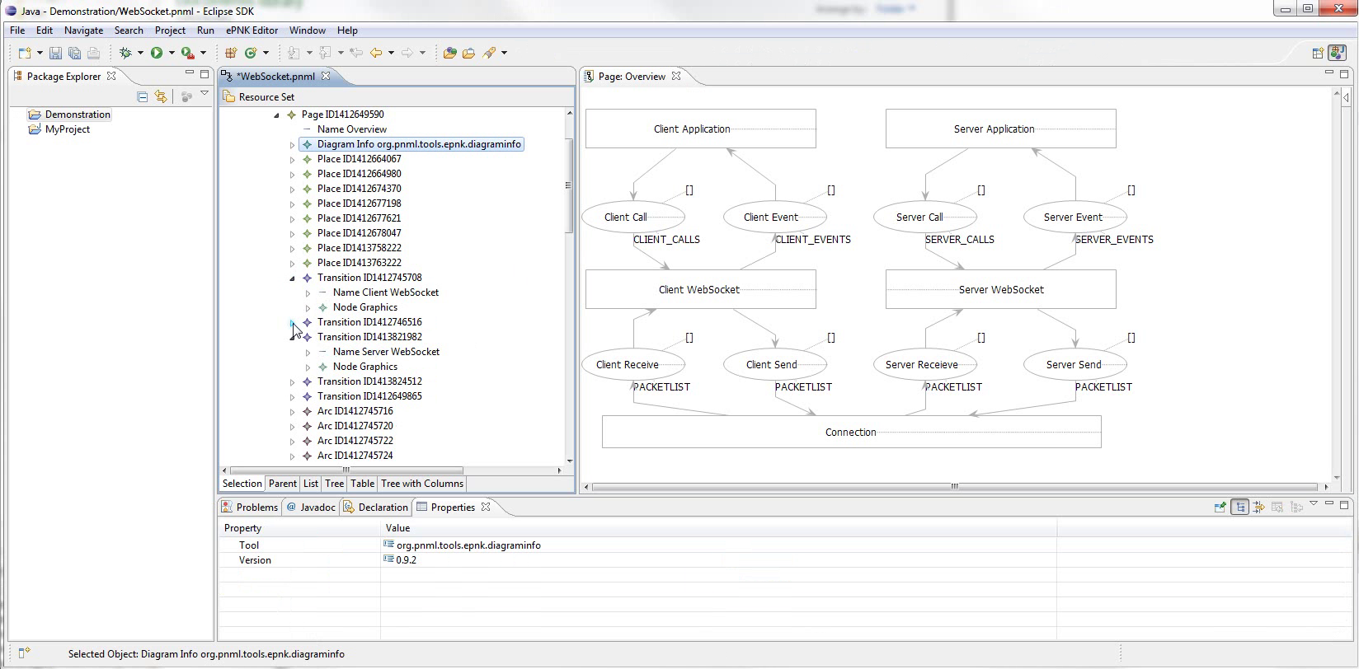
Notes:
Using editors together, we locate the model elements we want to annotate
First, annotate Principals

Slide 62
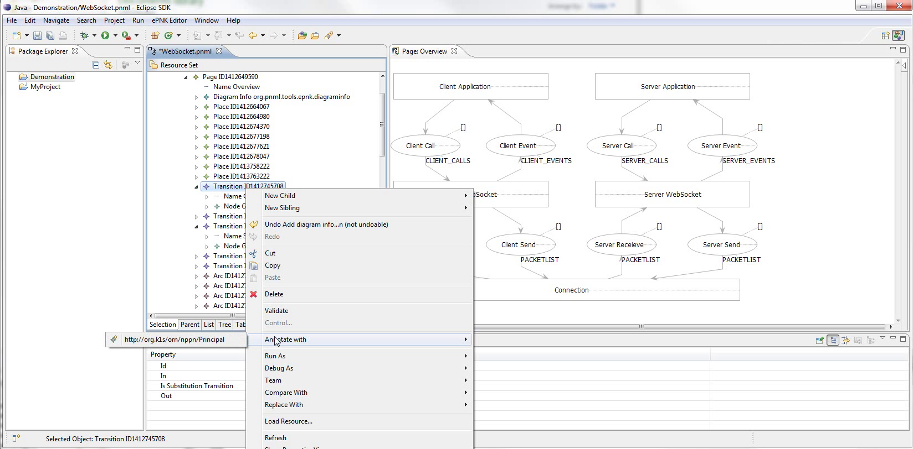
Notes:
Right click the element, show Annotate With submenu,
Zoom
shows only applicable pragmatics.

Slide 63
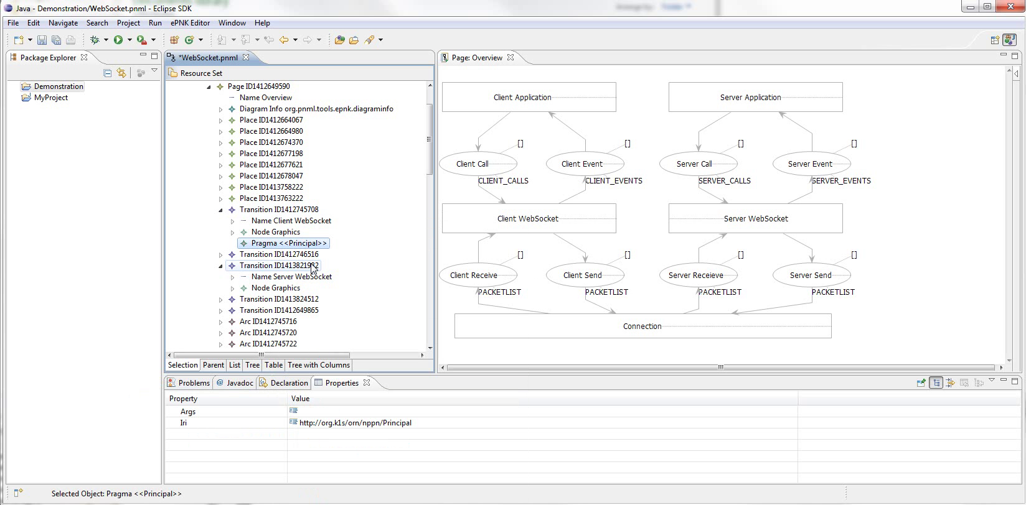
Notes:
Here the element is annotated.

Slide 64
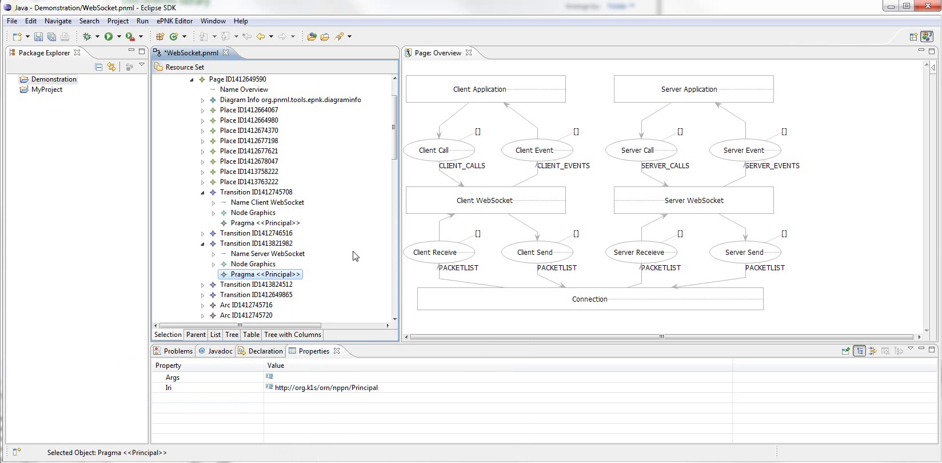
Notes:
And the other one as well.
Next, annotate channels

Slide 65
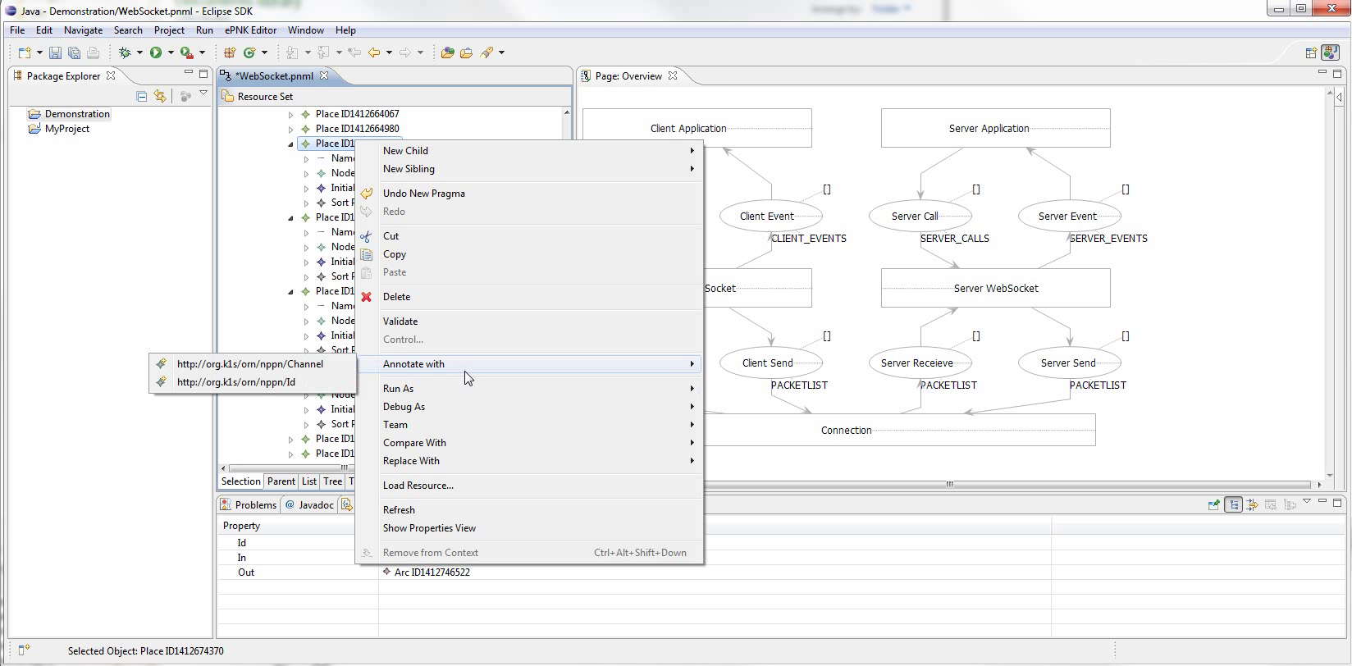
Notes:
Here we see the menu for a Place
Zoom
Emphasise that these are not exhaustive

Slide 66
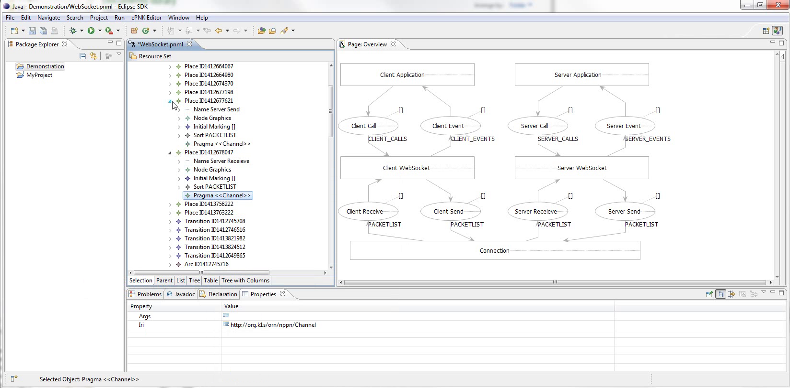
Notes:
Skip a little, And here the elements have all been annotated.

Slide 67
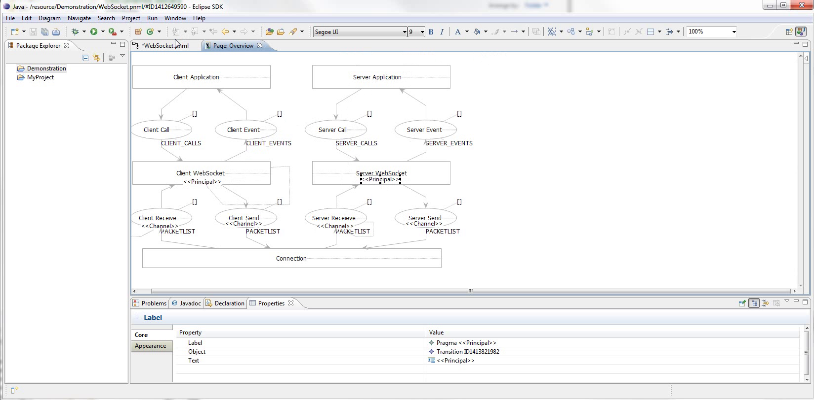
Notes:
To show this in the diagram editor, we need to close and reopen it.
New pragmatics will not automatically be properly positioned, but can be manually moved.
Zoom

Slide 68
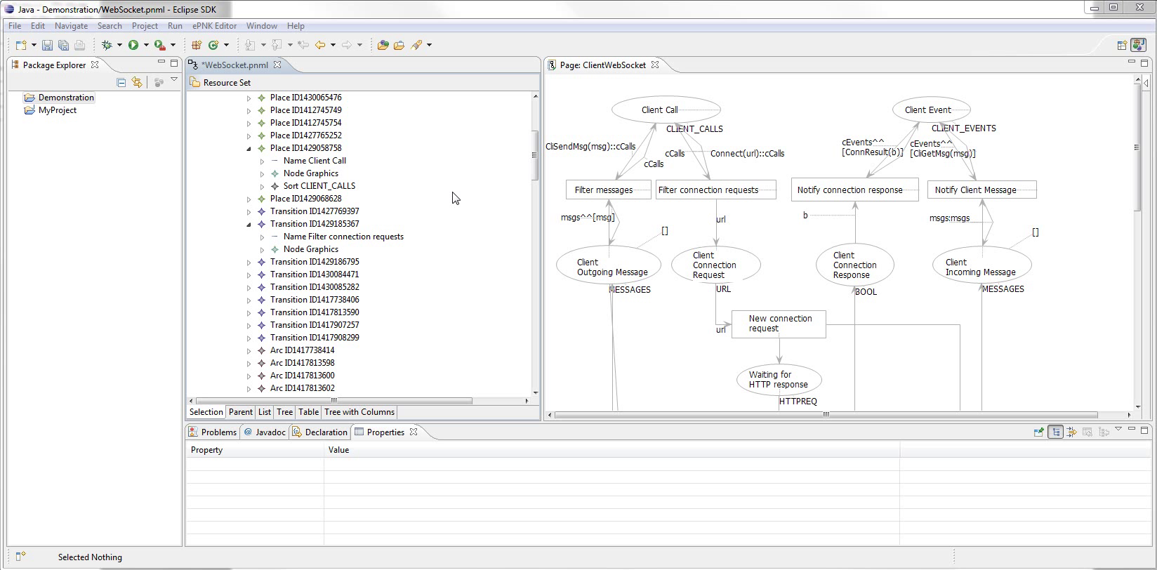
Notes:
Next up is the ID and External Pragmatics
Remember idea for them
So for example, one if the client calls is a connection request.
Zoom
Starts at transition Filter Connection Requests
But it needs to be connected by an incoming arc to a place annotated with Id

Slide 69
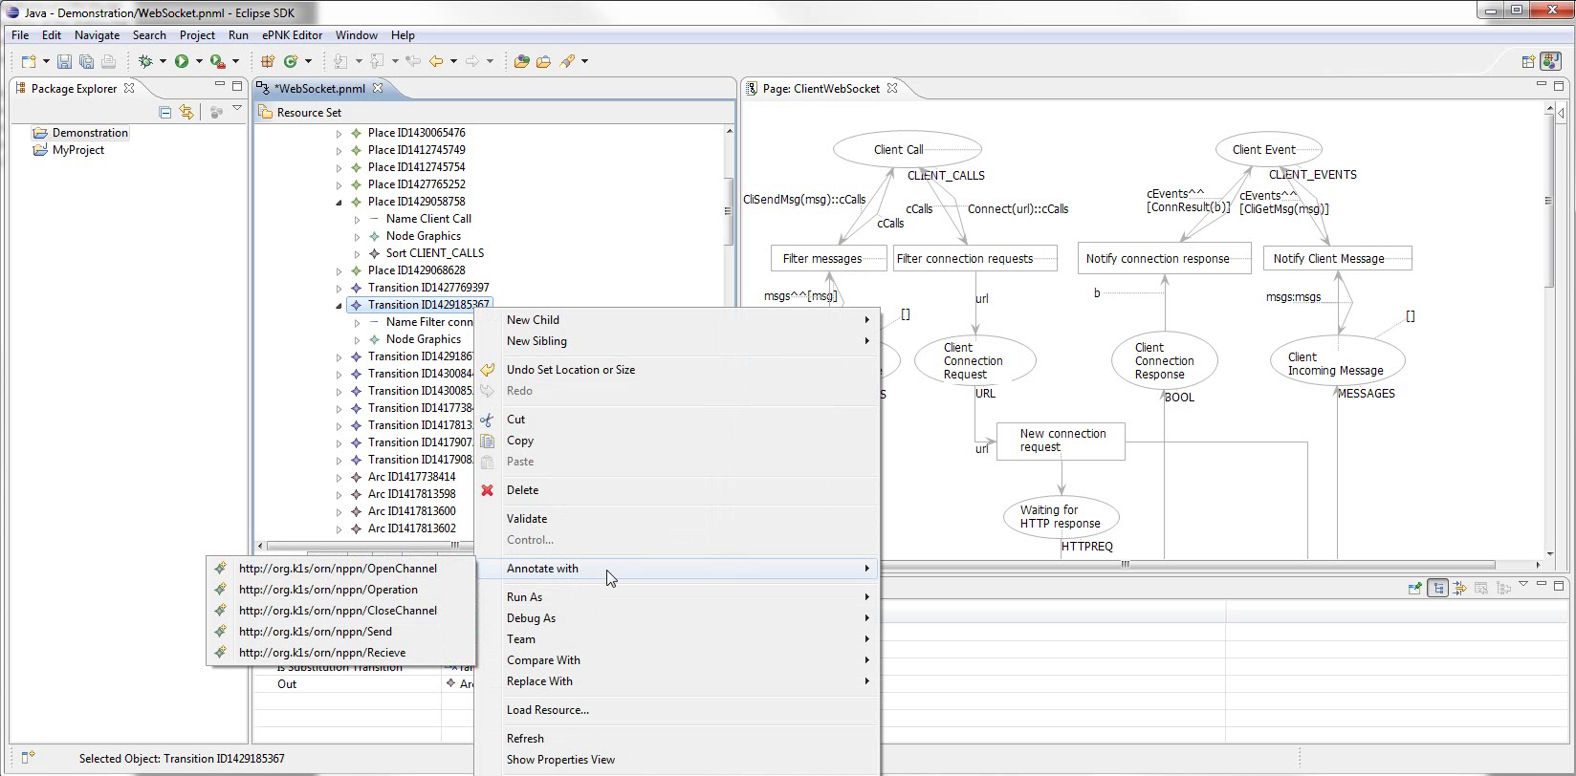
Notes:
If we try to annotate it,
Zoom
External isn’t available.

Slide 70
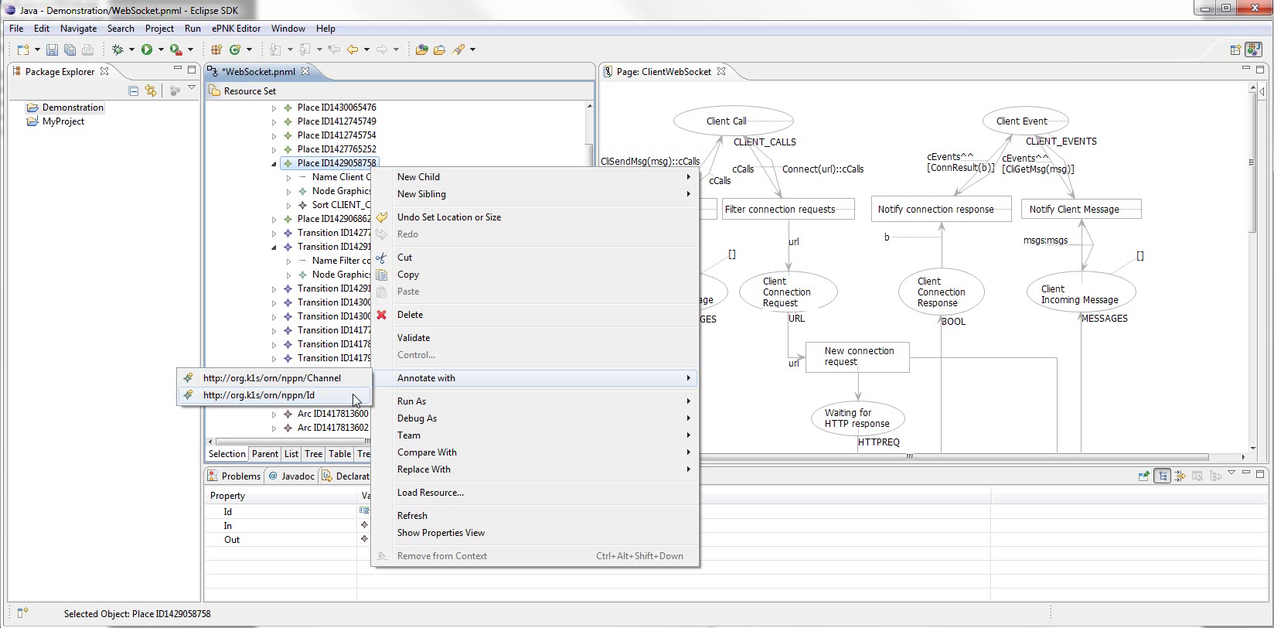
Notes:
However, if we first annotate Client Call with Id...

Slide 71
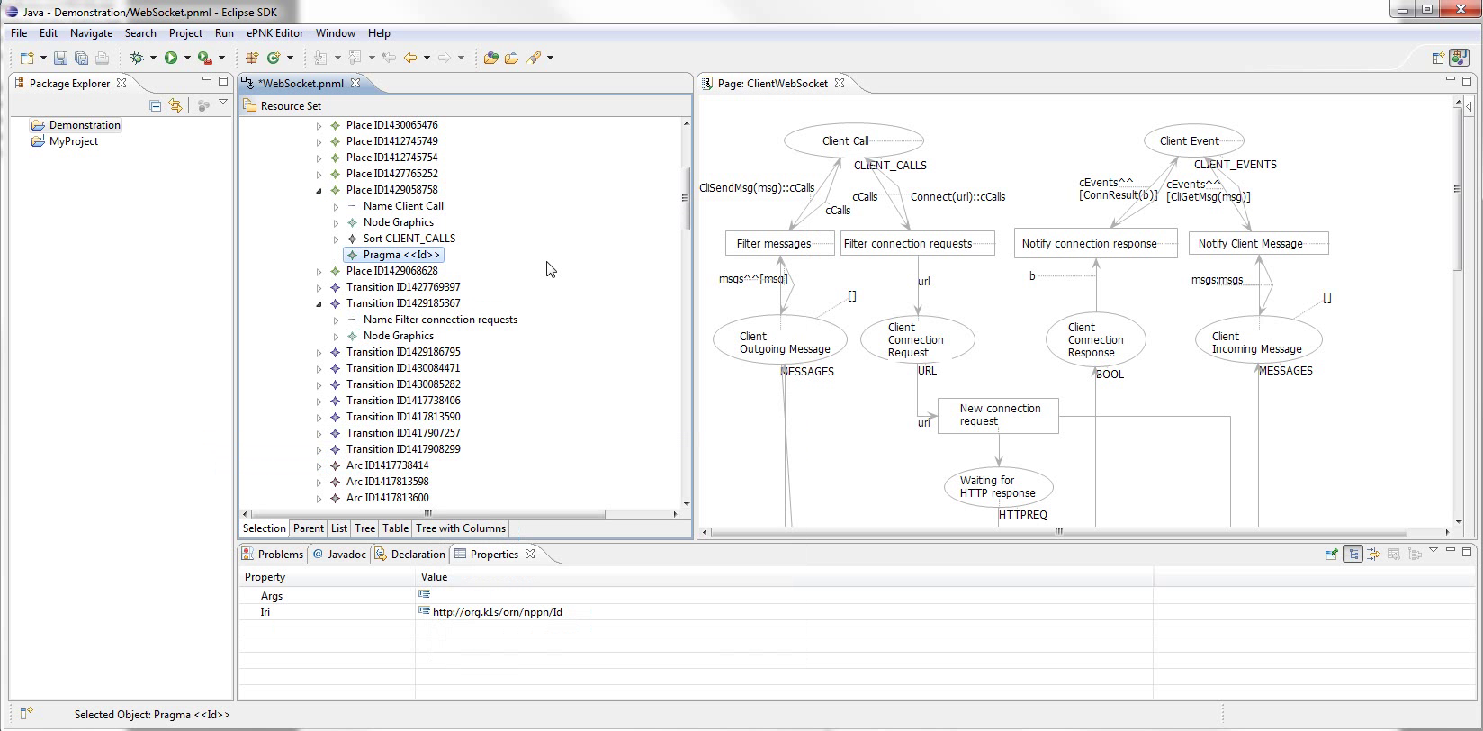
Notes:
Like so...

Slide 72
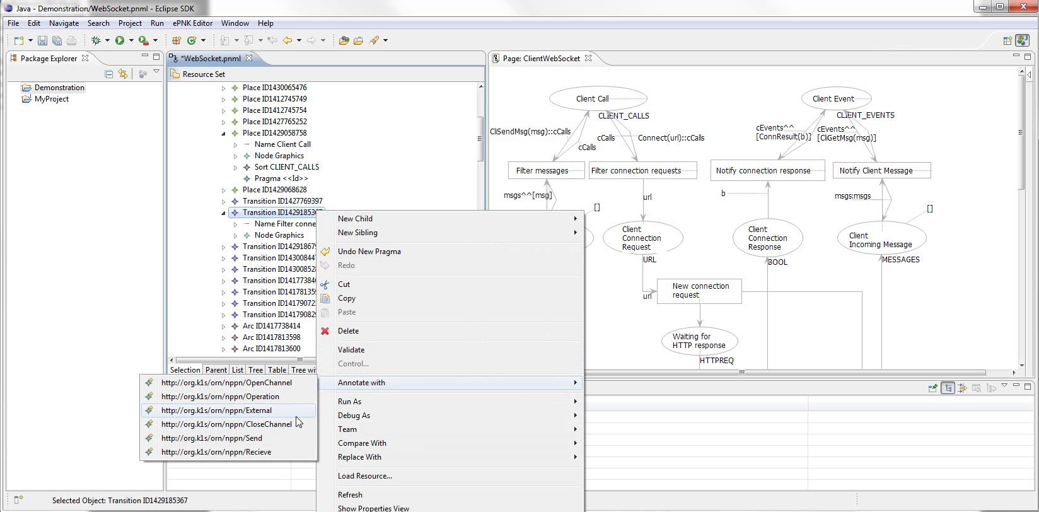
Notes:
Zoom
We now have External as an option for the transition

Slide 73
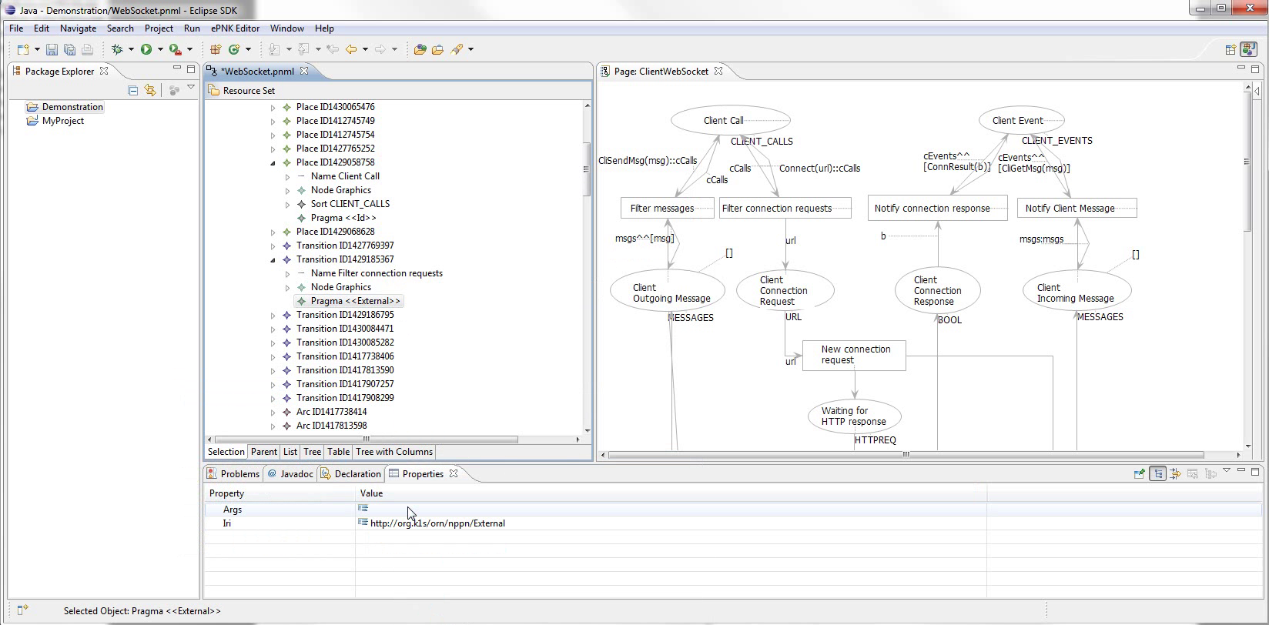
Notes:
Good time to demonstrate pragmatics arguments
zoom
Note that a pragmatic has a property args.
In the case of External, it signifies actual arguments for the external method.
If we click to edit it...

Slide 74
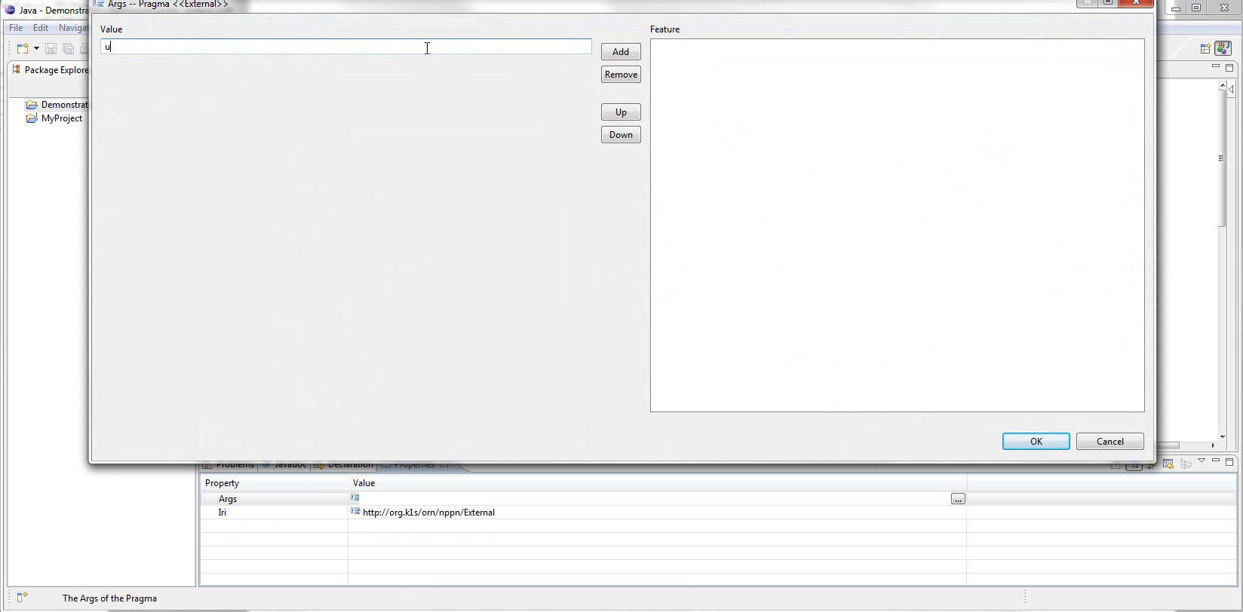
Notes:
We’re given a generic editor
Args is defined as a list of strings, so the editor lets us add and remove strings

Slide 75
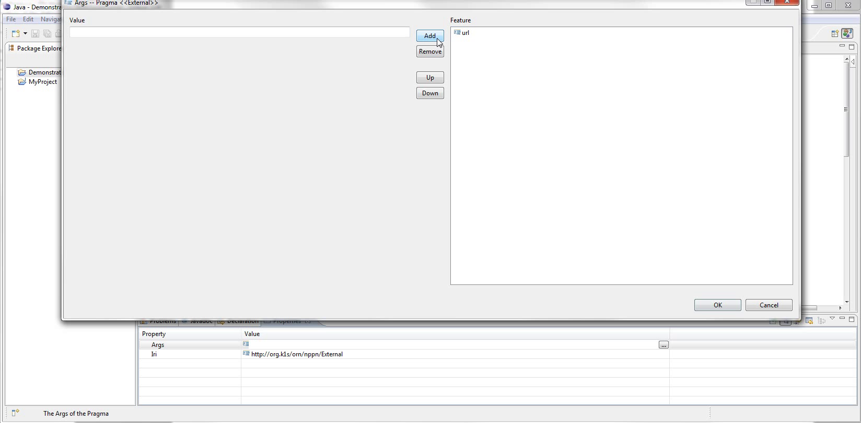
Notes:
We add the argument «url»

Slide 76
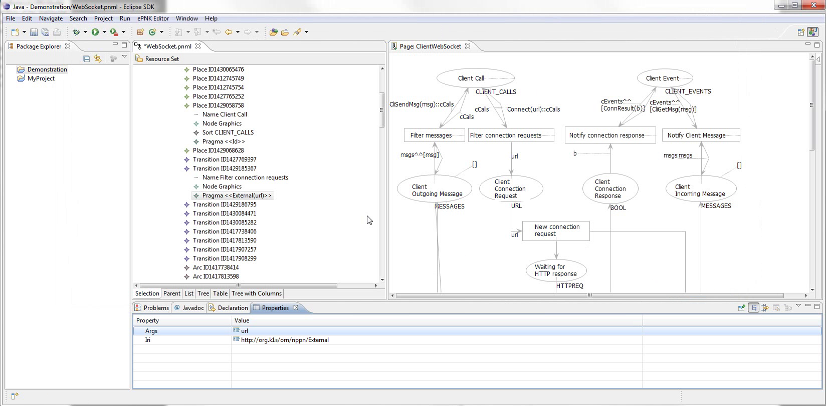
Notes:
And it’s now displayed in the pragmatic label

Slide 77
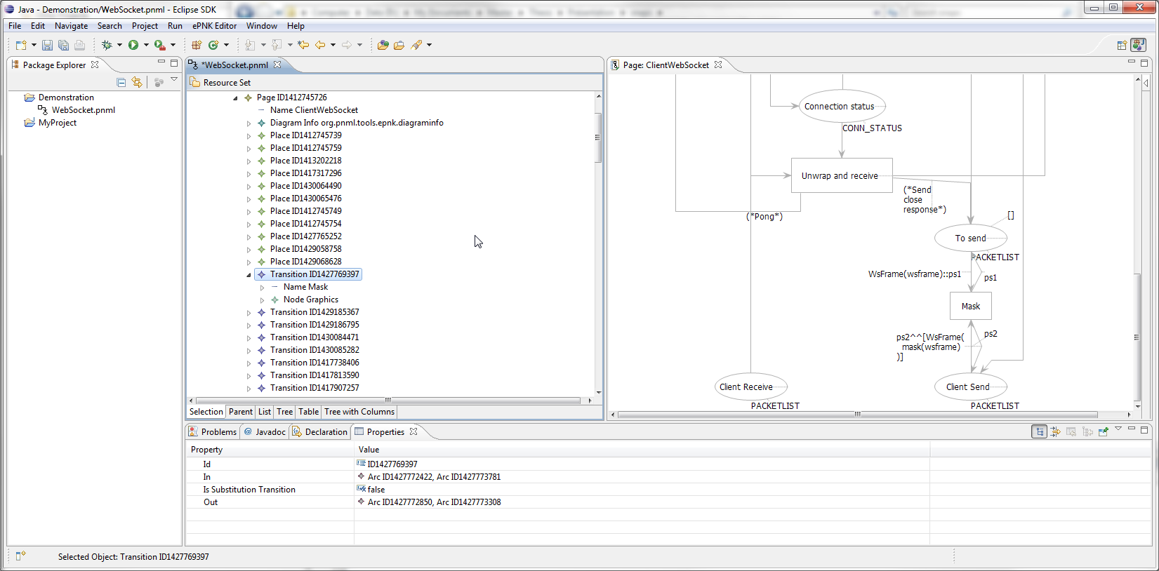
Notes:
Finally, show model specific pragmatics.
Suppose we want or need to handle masking specially
Showing the Mask transition
Let’s make a specific pragmatic for it

Slide 78
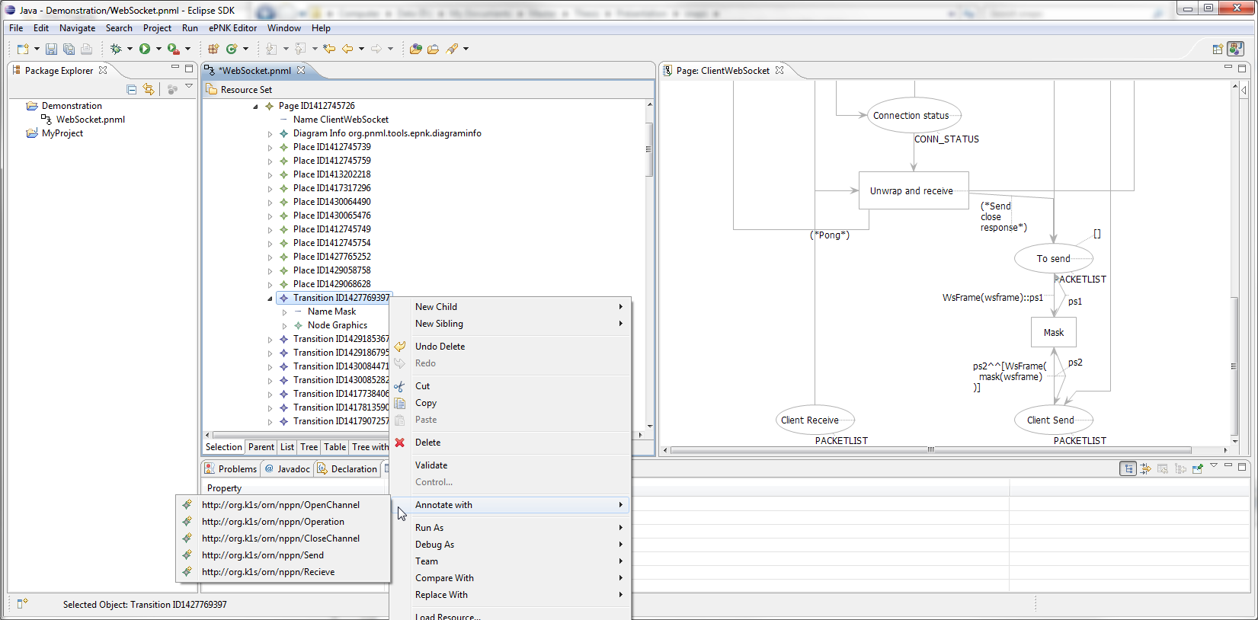
Notes:
Just to make sure, here’s the usual list for a transition

Slide 79
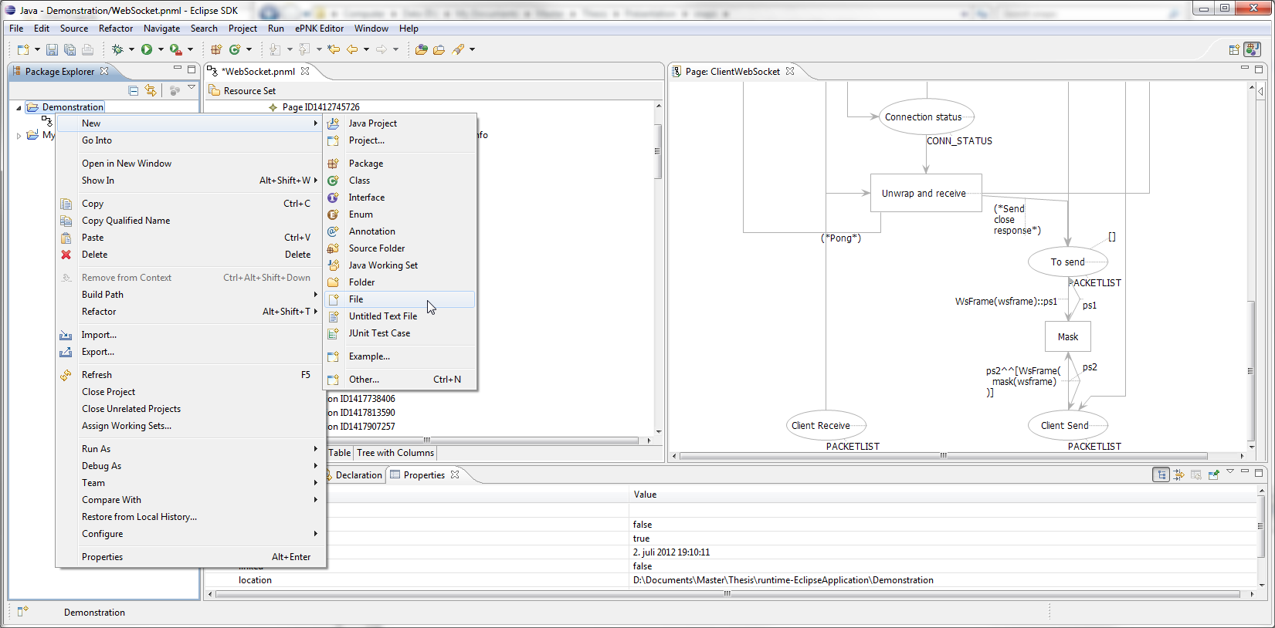
Notes:
We need to write an ontology for the pragmatic, so we create a new blank file.
Again, several ways
We right-click project, new, file

Slide 80
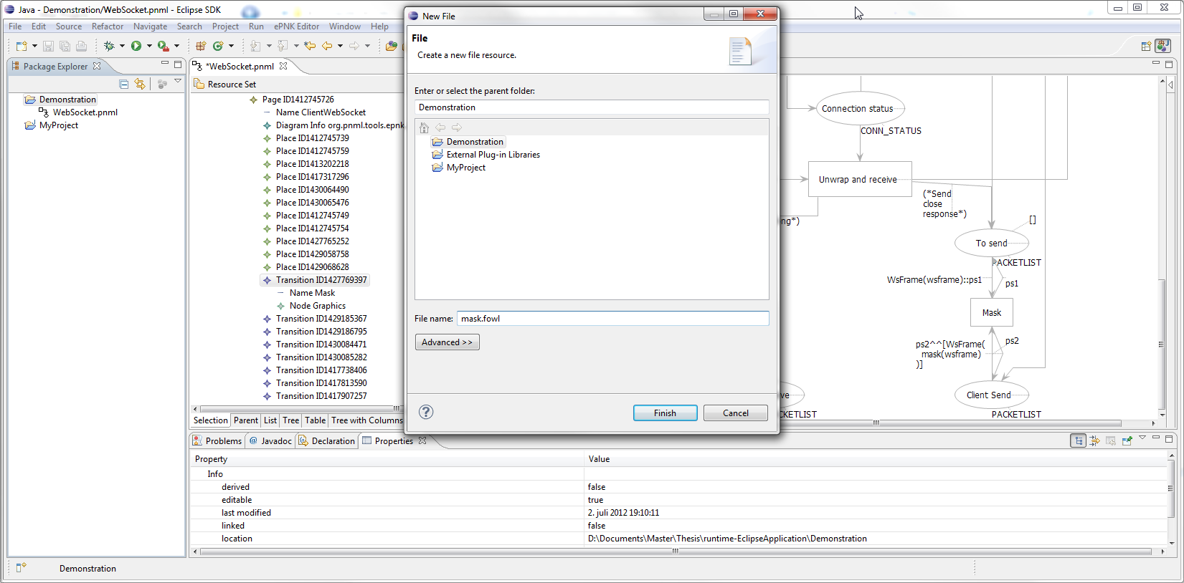
Notes:
Name it mask.fowl
Zoom

Slide 81
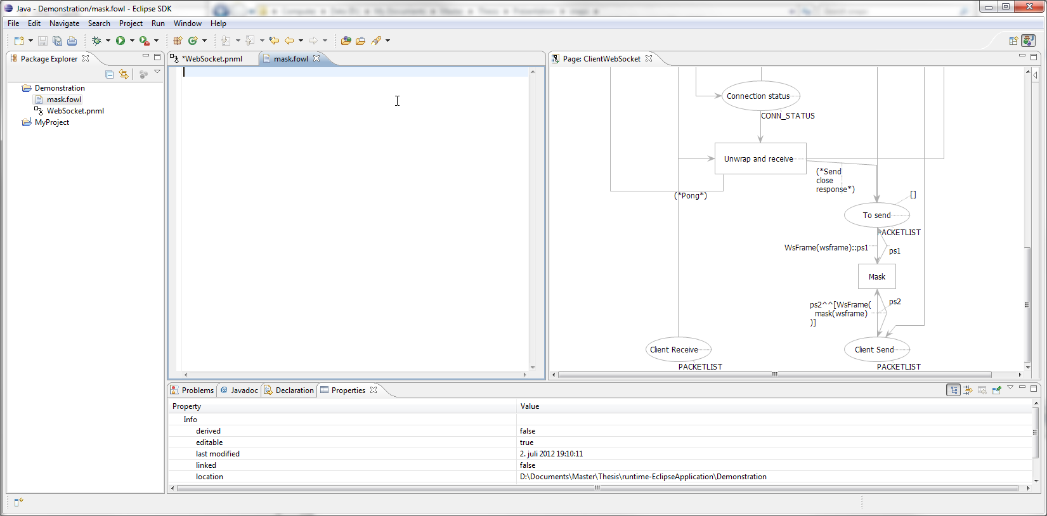
Notes:
The extension makes Eclipse automatically load an appropriate editor for the new file.
Simonsen has provided a basic editor with a few content assist features
If we activate it with ctrl space

Slide 82
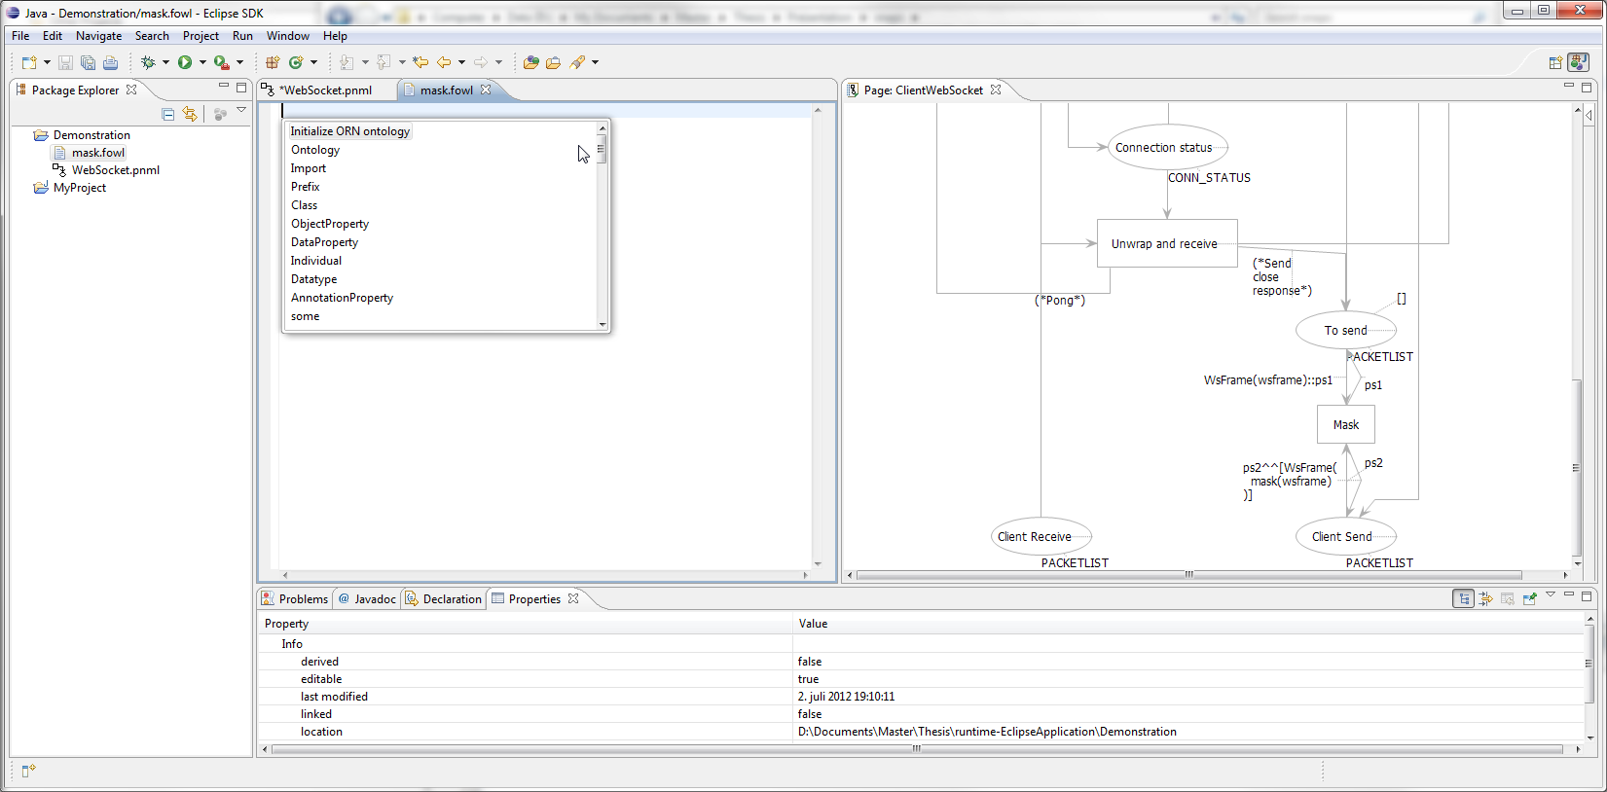
Notes:
We are given a list of suggestions that can be inserted
Including a block of text containing default imports for pragmatics ontologies

Slide 83

Notes:
Here is the result of selecting it

Slide 84

Notes:
We write our axioms, simply defining the classes Mask and Unmask, and restrict that both must belong to transition.
Save the file and close it.

Slide 85

Notes:
Back in the model, find Pragmatics Ontology at the bottom
Right click it

Slide 86

Notes:
Select pragmatics
Zoom
Add ontology

Slide 87

Notes:
File selector for all files in containing project
Not filtered for extensions currently, as not all ontology editors use correct extensions, and OWL API only looks at file contens
Same method used to add domain specific pragmatics
Could be extended to add ontology documents available online as well.

Slide 88

Notes:
Here we see (zoom) the ontology as a child element
Will be persisted and loaded (provided file still exists)

Slide 89

Notes:
And if we try to annotate the transition now

Slide 90

Notes:
zoom
Mask and Unmask is available

Slide 91

Notes:
Here the pragmatichas been placed.

Slide 92
Evaluation

Slide 93
Prototype Evaluation
All requrements met
Importing CPN Tools models.
Annotate model with pragmatics.
Loading sets of domain-specific pragmatics
Define set(s) of model-specific pragmatics
Proof of concept for Simonsen’s ideas

Slide 94
Performance
Time to determine approprite pragmatics too long
25 elements: ~1 second delay
Kao-Chow – 96 elements: ~7 seconds
WebSocket – 372 elements: Minutes...
Cause: Ontology Closed World Reasoning
Workaround: Only consider elements on single page
Better solution: Changes to reasoner engine

Slide 95
Thesis Evaluation
Example of applied Model Driven Engineering
Working prototype
Needs refinement and additions
Suggestions in paper
Have not extensively shown the potential of ontologies for defining pragmatics

